Slide 1
Assignment 6
Luke Profio

Slide 2
Few-Shot Summarization
Few-shot in-context learning was used by providing three clinical notes paired with manually generated ‘lay summaries.'
The model was prompted to learn the summarization pattern from the lay summaries.
Patient-facing clarity was an important factor in ensuring that medical details like diagnoses were outputted into proper summaries.
The model output was prompted to be accessible to a broad, non-medical audience.

Slide 3
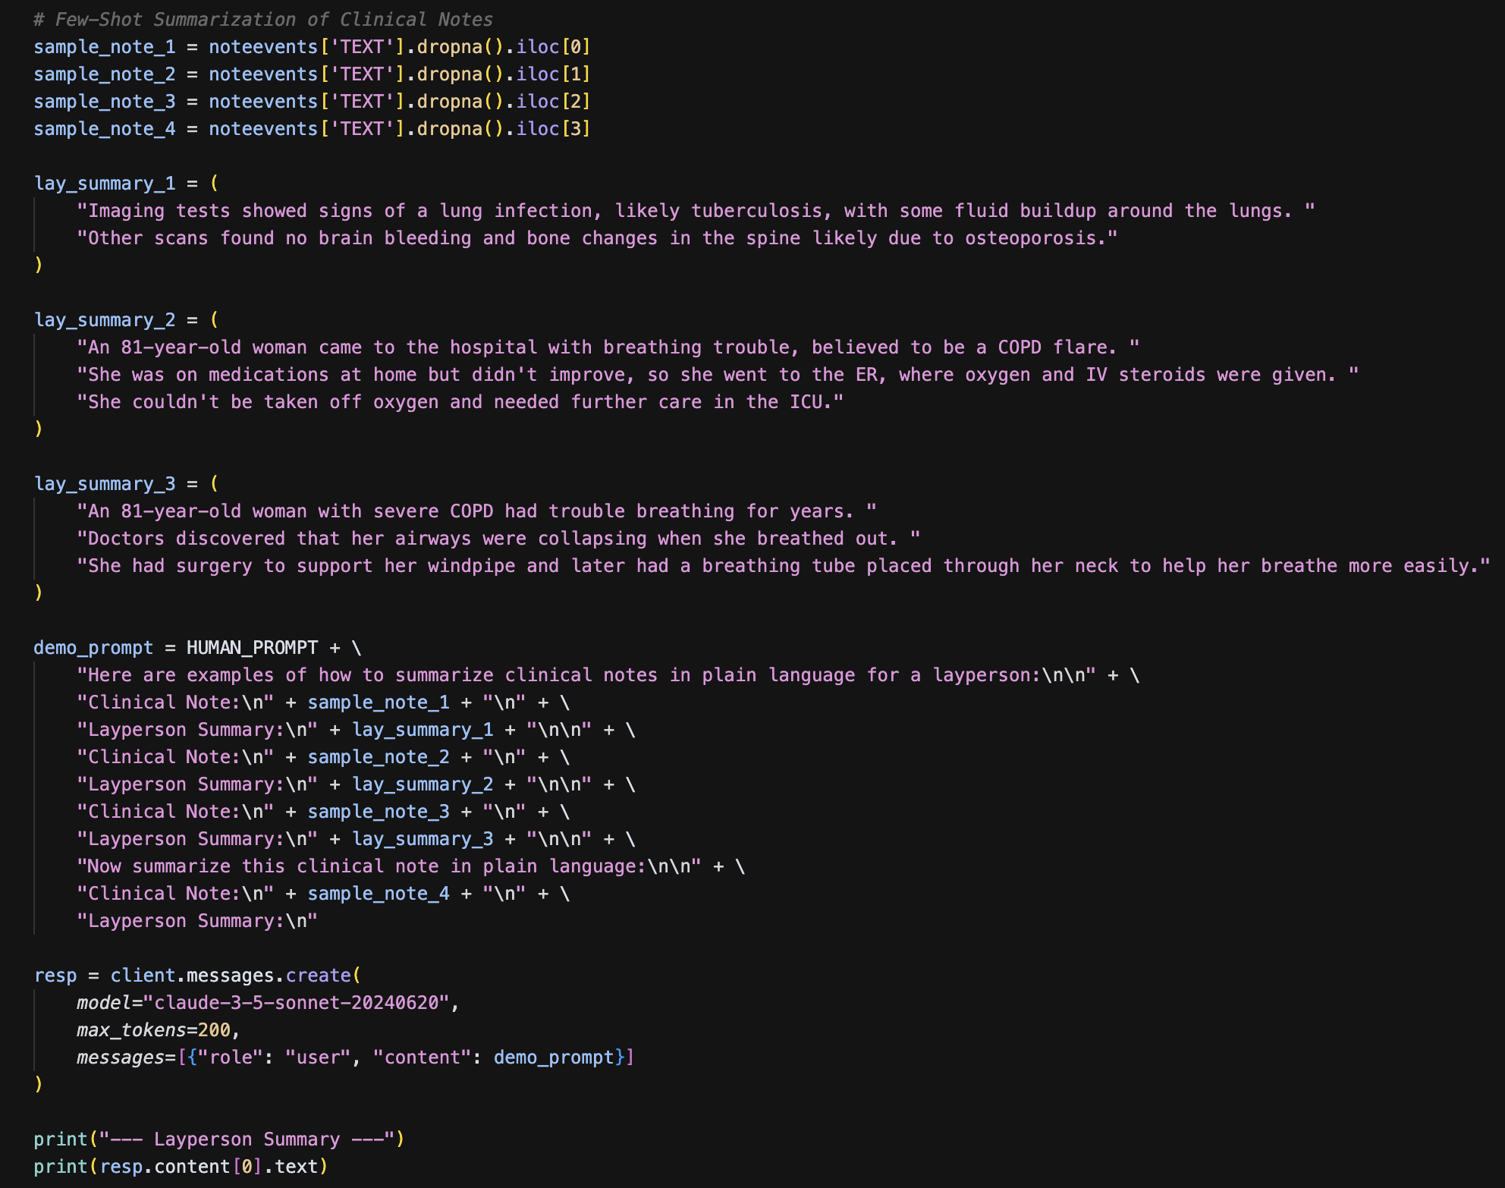
Few-Shot Summarization Implementation

Slide 4
Few-Shot Summarization Output
--- Layperson Summary --- Here is a summary of the clinical note in plain language: An 87-year-old woman with a history of lung and heart problems was admitted to the hospital with severe shortness of breath. In the emergency room, she had trouble breathing and needed a breathing tube placed. She was treated in the intensive care unit with medications including steroids and antibiotics. While in the ICU, she developed bleeding in her stomach, which was examined with a camera procedure. This showed inflammation and ulcers in her esophagus and stomach. After about a week, doctors were able to remove the breathing tube and she slowly improved. She was moved to a regular hospital room where she continued to get better. By the time of discharge, she was able to breathe with just oxygen through nasal prongs. The doctors made some changes to her medications, including adding stomach protection medicine, water pills, and tapering down steroids. They stopped some of her

Slide 5
Few-Shot Summarization Interpretation
This approach accurately tracks the tone and structure of the examples provided. It has a clear understanding of how to translate clinical terms into layperson summaries.
Despite the unstructured data involved, the summary correctly identifies key medical events and captures their patterns with minimal deviations.

Slide 6
Chain of Thought
We prompted the model to produce structured clinical reasoning by providing guidance on how to extract abnormal findings, timelines, and more from a single note.
Chain of thought instruction included step-by-step reasoning over summarization like in the previous example.
Reasoning of the note was to be grounded in factual data, so fidelity was an important factor in the overall prompt.
Chain of thought reasoning was shown to be a foundation for other prompting methods, such as classification which we explore later.

Slide 7
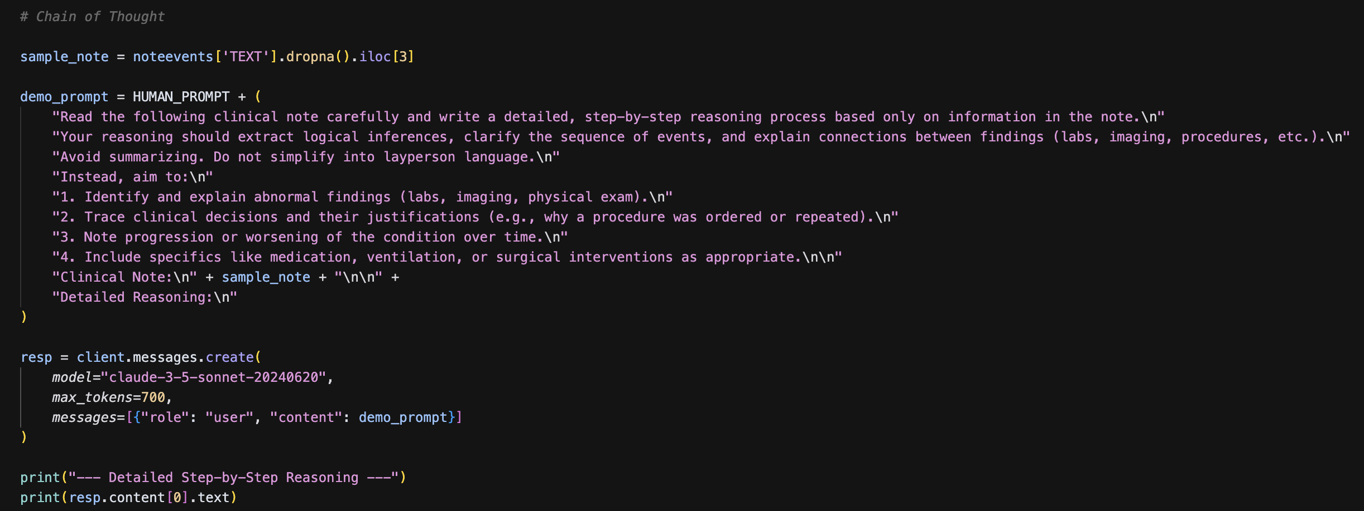
Chain of Thought Implementation

Slide 8
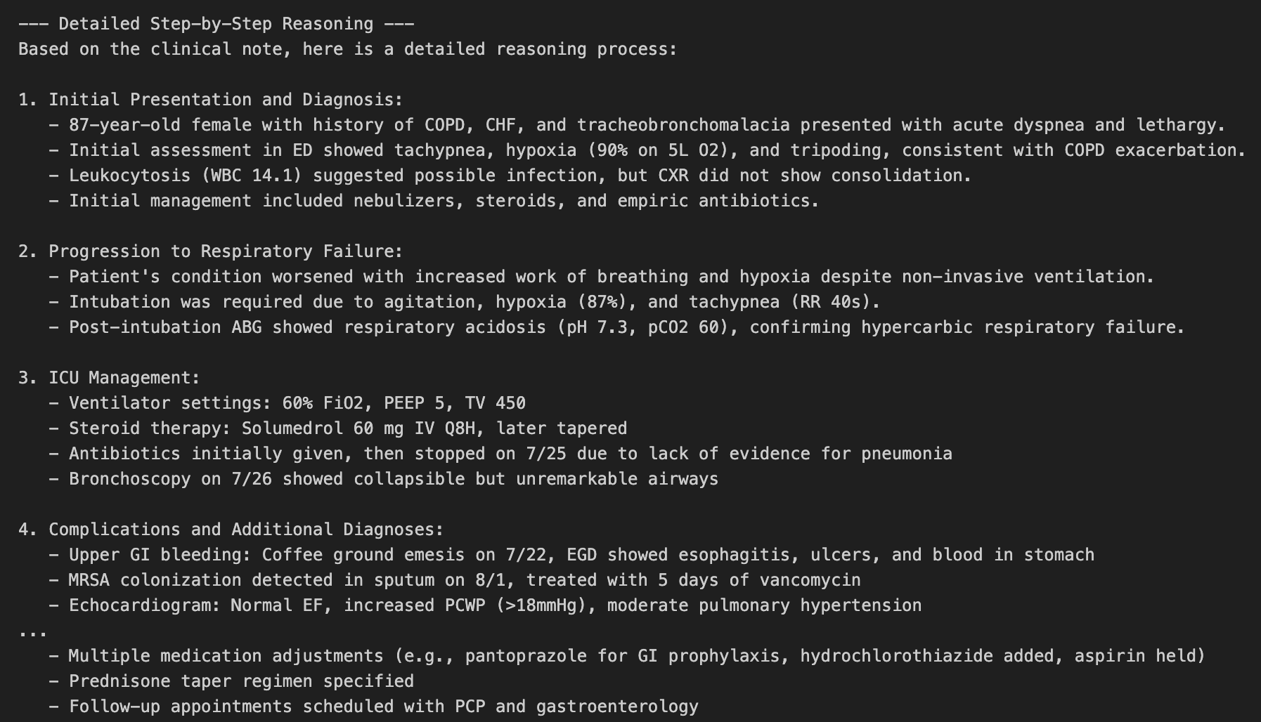
Chain of Thought Output

Slide 9
Chain of Thought Interpretation
This approach follows a logical clinical timeline from presentation through diagnosis, and mirrors clinical reasoning steps.
It also accurately draws links between lab findings, exhibiting strong synthesis in its outputs.
Versus Chain-of-Thought, this approach avoids oversimplification and retains clinical specificity.

Slide 10
In-Context Learning
We provided three labeled examples of reasoning from clinical notes.
The prompt showed the model the task pattern directly within the input, without other methods.
We asked the model to apply the same reasoning to a novel note.
This showed the capabilities of LLM reasoning from in-context examples alone.

Slide 11
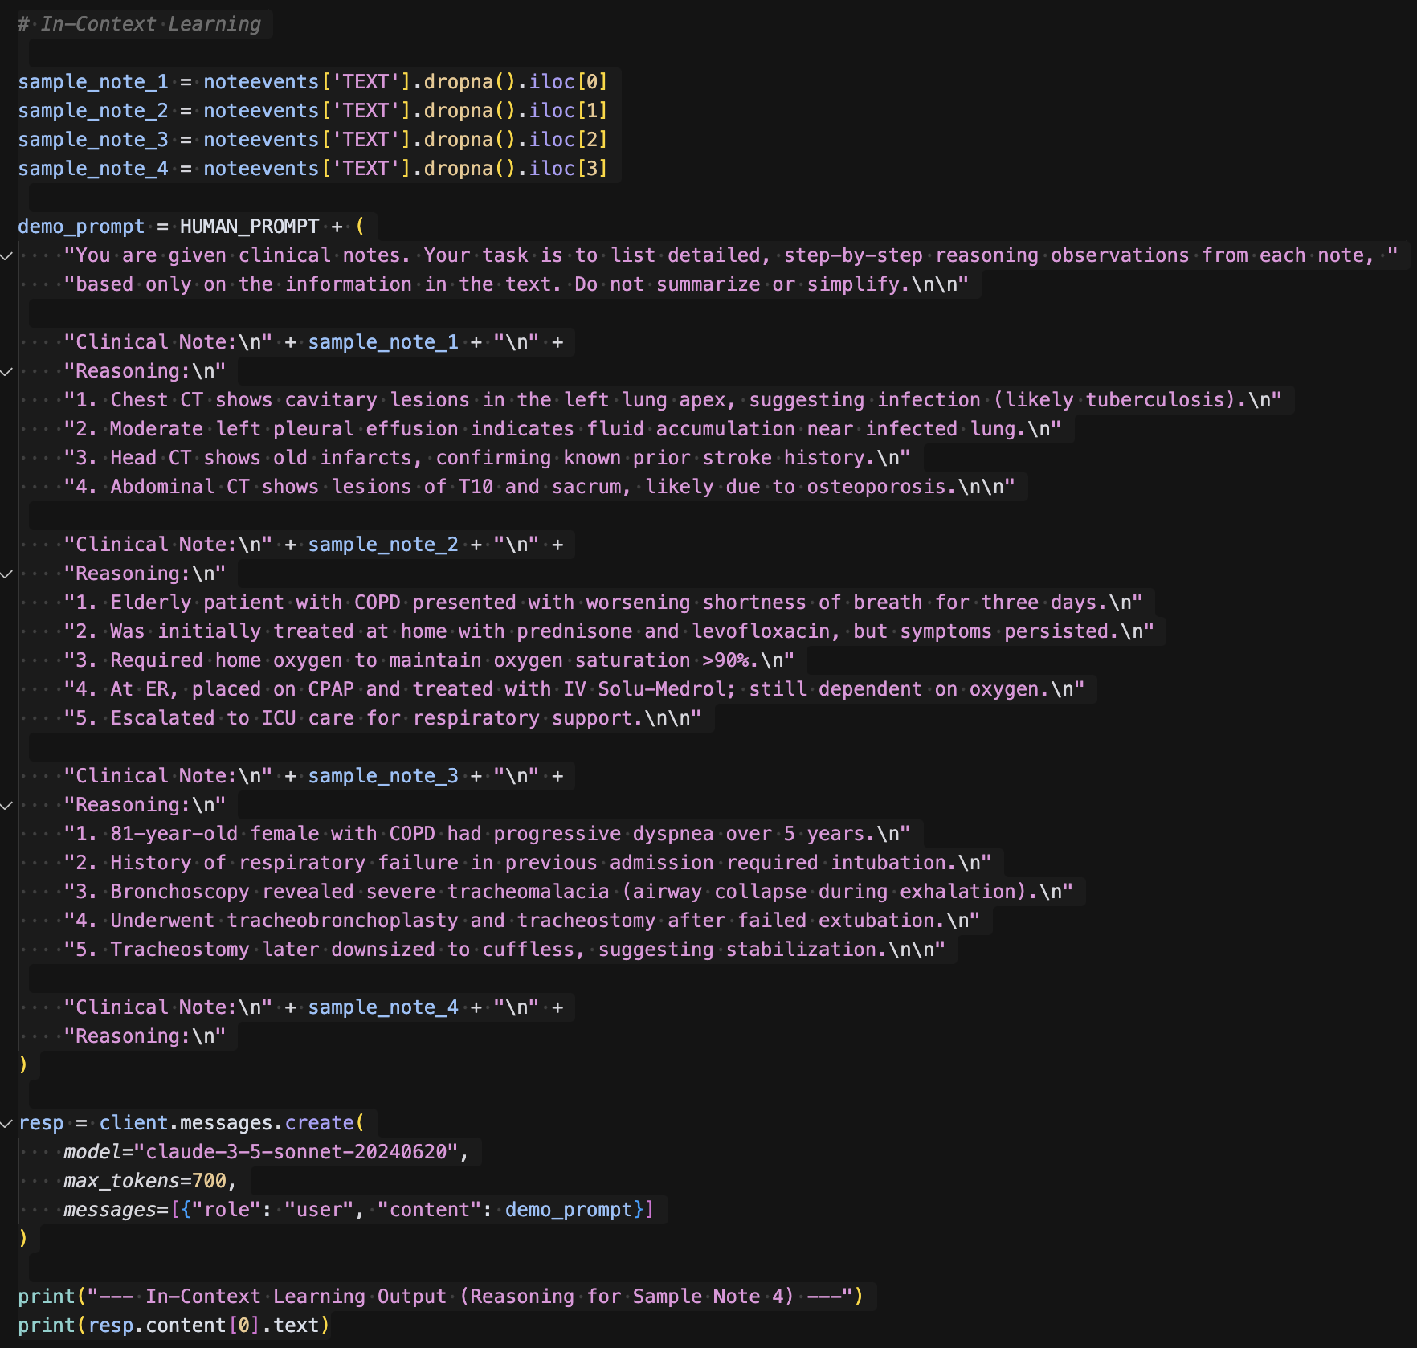
In-Context Learning Implementation

Slide 12
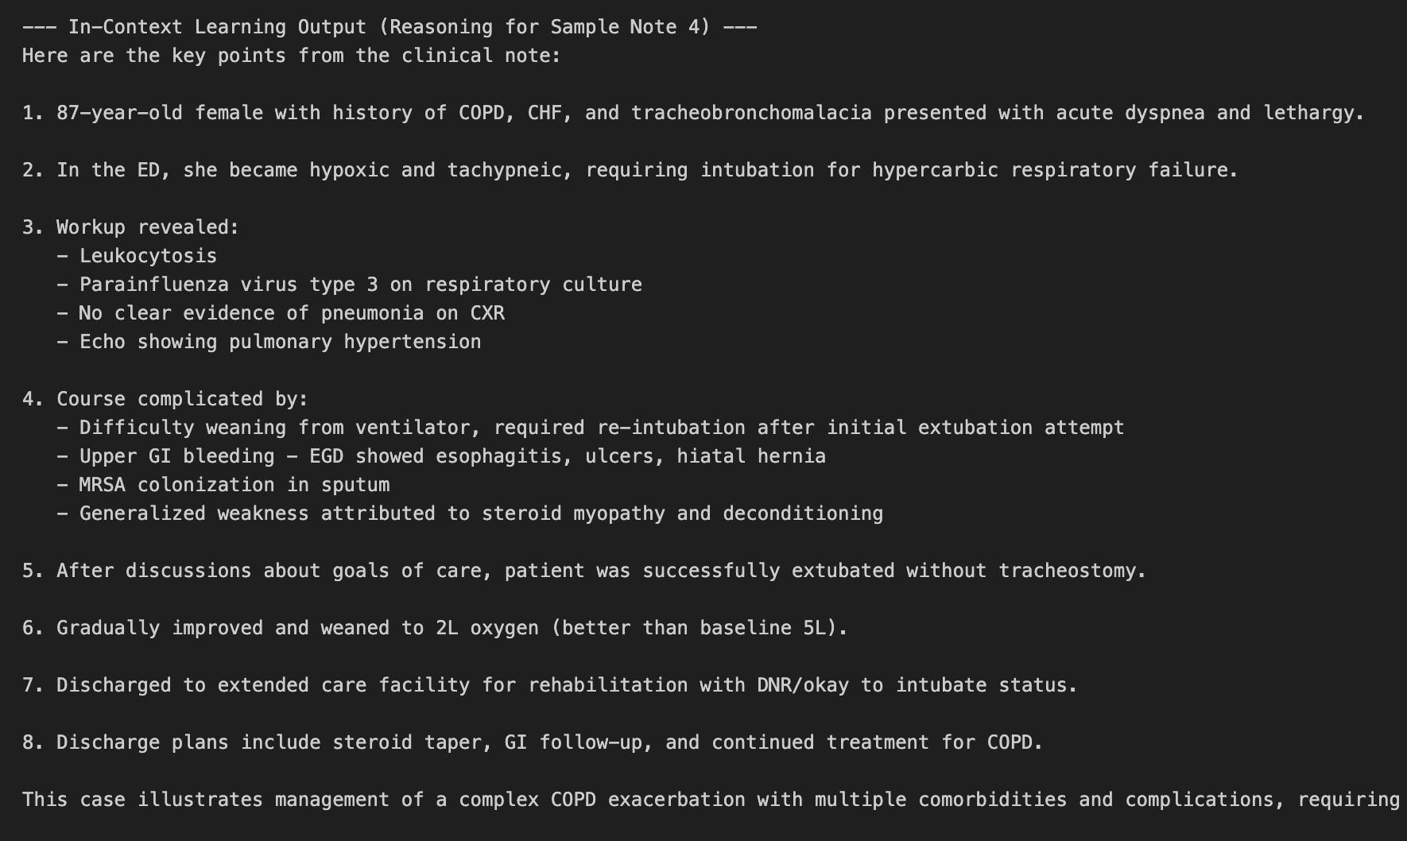
In-Context Learning Output

Slide 13
In-Context Learning Interpretation
This approach accurately mimics the structure and detail shown in the examples fed in. So it can infer and apply reasoning patterns effectively.
Step-by-step observations are medically valid.
It has a nuanced understanding of the medical context, in this case linking the patient’s gradual weaning from oxygen to clinical recovery, and goals of care discussions.
It is also grounded in the source note.

Slide 14
Tree of Thought
We generated multiple reasoning paths from a clinical note to assess other implementations.
We prompted the model to evaluate and compare both reasoning chains for clinical competency.
The final classification (disposition) was selected based on comparative path quality.
Reasoning and decision-making beyond linear chain of thought methods were shown in the output.

Slide 15
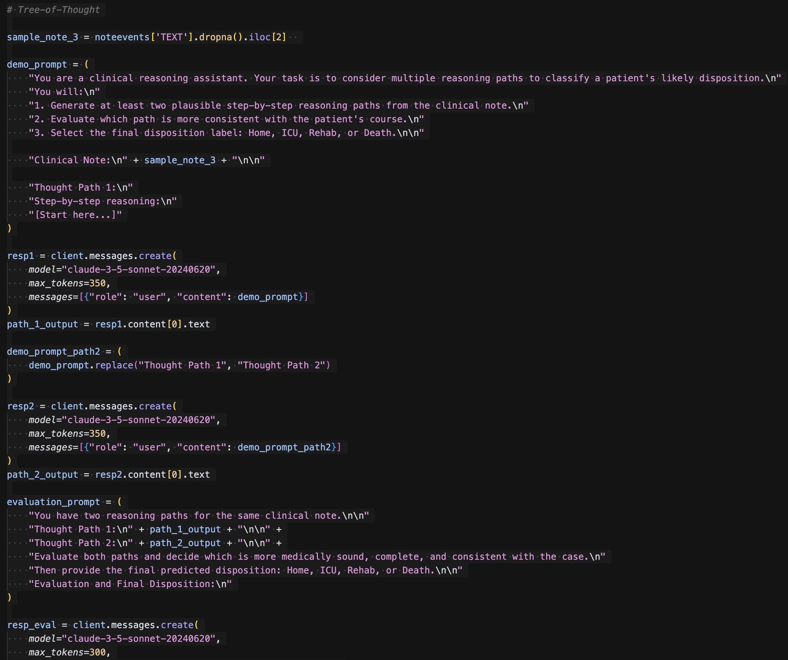
Tree of Thought Implementation

Slide 16
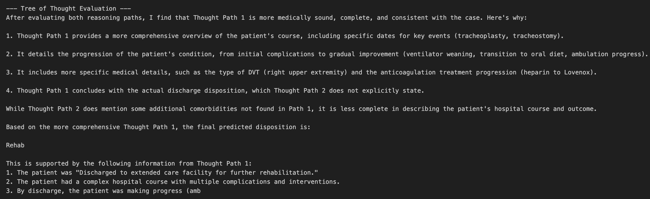
Tree of Thought Output

Slide 17
Tree of Thought Interpretation
This approach successfully generated multiple plausible clinical trajectories.
The evaluation step compared key factors across both paths, selecting the one with better alignment.
The output was also consistent with actual case discharge documentation with minimal guidance in that regard.

Slide 18
[Bonus] Classification
We used few-shot in-context learning with 3 labeled examples to teach disposition prediction, a classification task.
Chain of thought reasoning was incorporated before each prediction to aid in interpretability.
We prompted the model to act as a classifier by producing a discrete label (Home, ICU, Rehab or Death).
The model’s output was treated as a downstream, clinical decision.

Slide 19
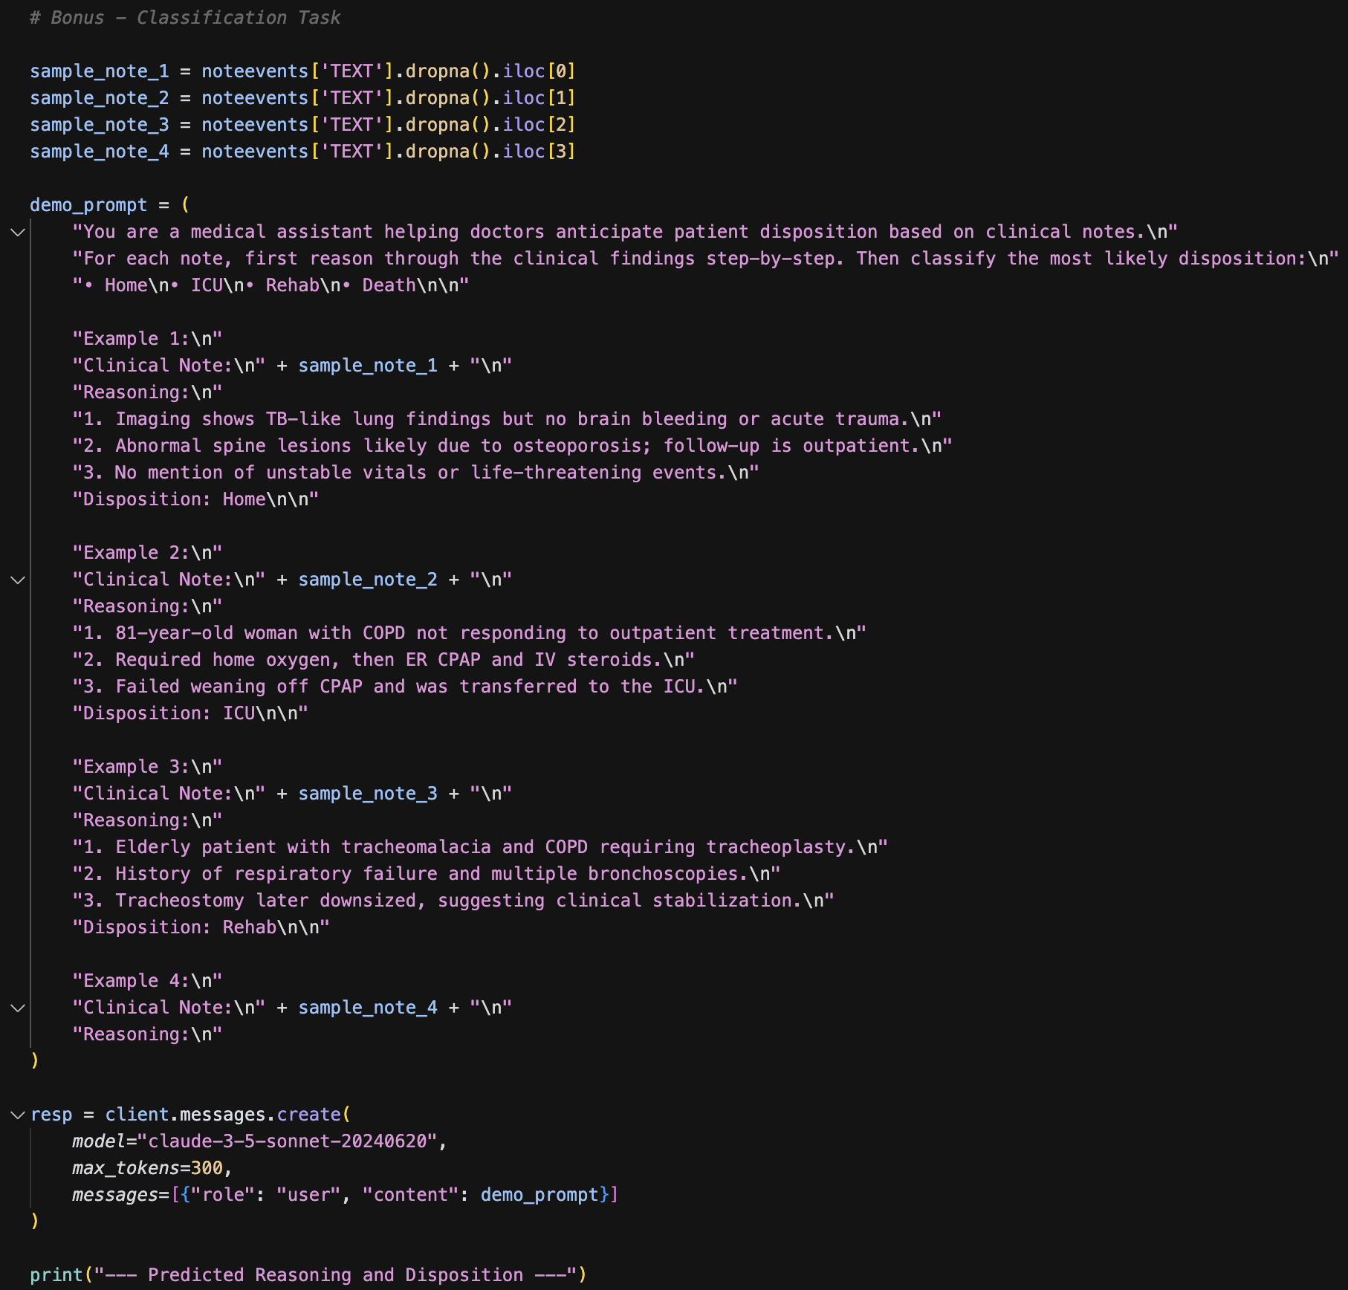
[Bonus] Classification Implementation

Slide 20
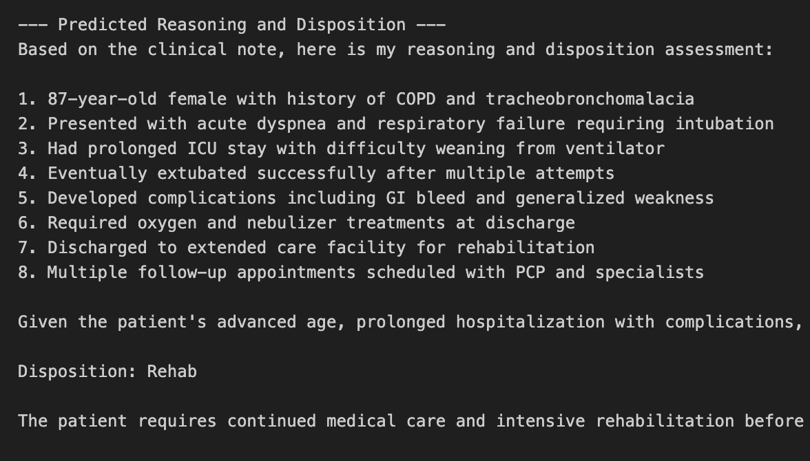
[Bonus] Classification Output

Slide 21
[Bonus] Classification Interpretation
This approach accurately combines clinical interpretation with more structured decision making.
The classification of Rehab follows clinical reasoning, in this example.
It uses step-by-step justification as to its premises, which supports in the overall output.

